Slide 1
CS6120: Lecture 10 Lexical Semantics
Kenneth Church
https://kwchurch.github.io/

Slide 2
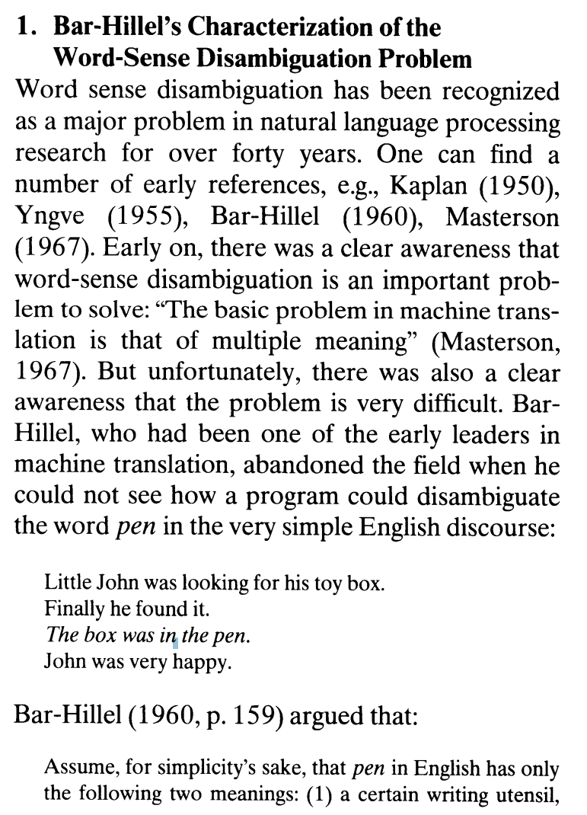
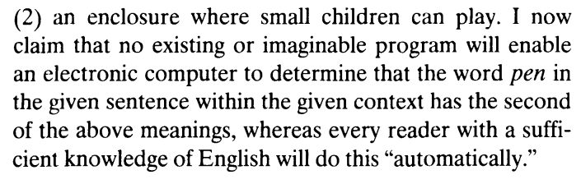
Word-Sense Disambiguation (WSD) is “AI Complete” Bar-Hillel (1960)
A method for disambiguating word senses in a large corpus (Gale, Church & Yarowsky, 1991)

Slide 3
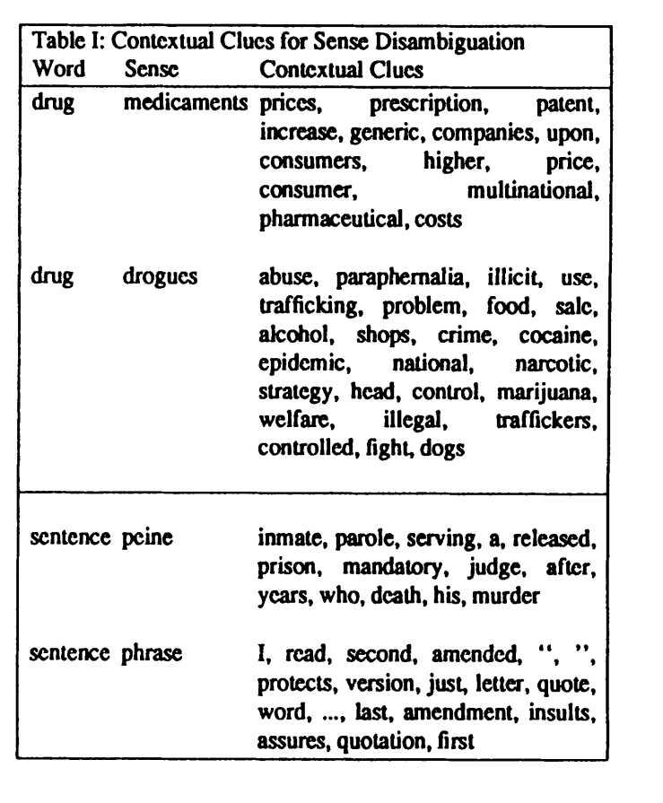
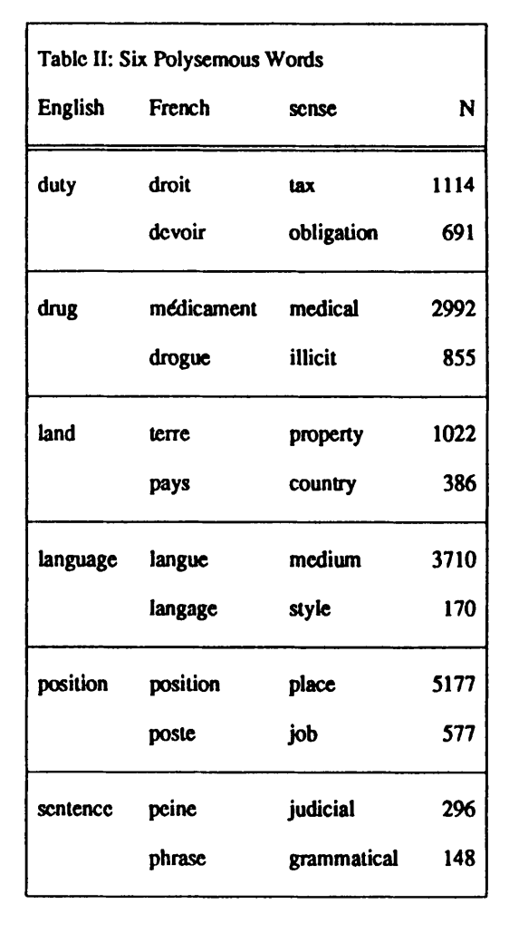

Slide 4
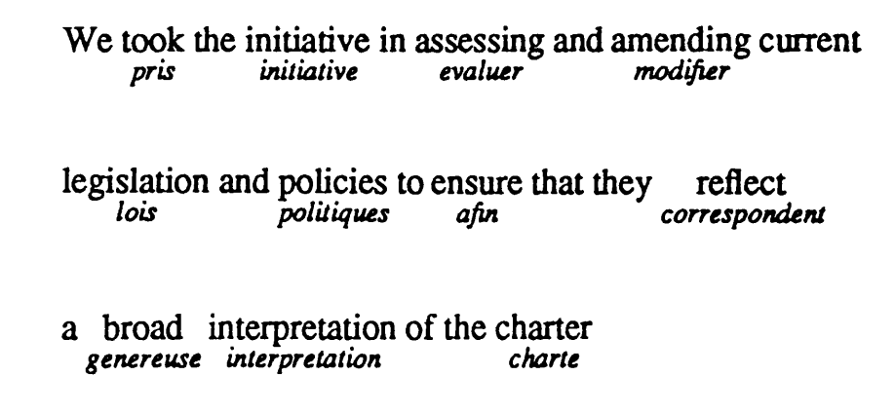
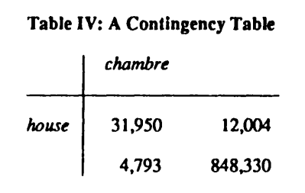

Slide 5
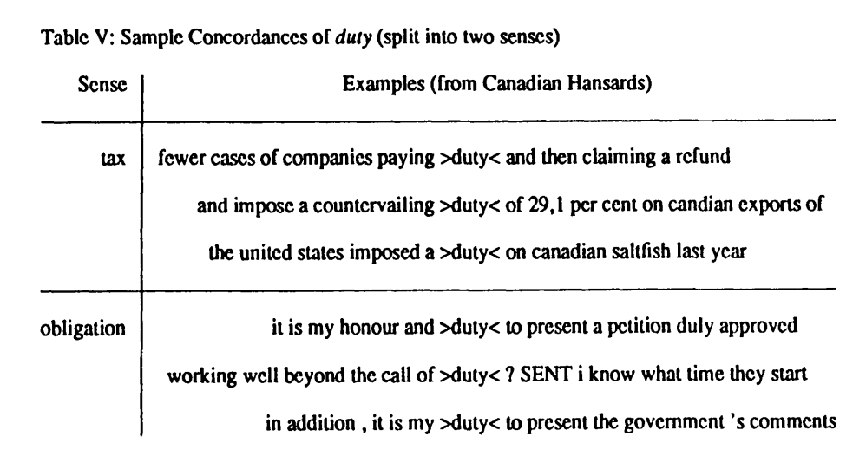
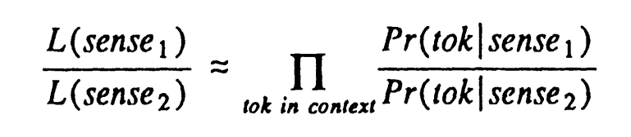

Slide 6
Repositories
HuggingFace
LDC (Linguistic Data Consortium)
NLTK

Slide 7
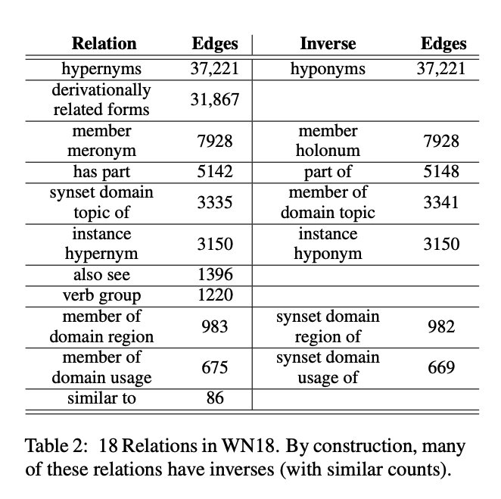
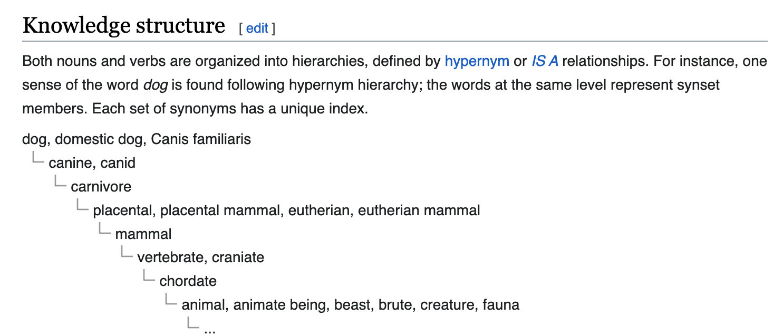
WordNet: An Example of an Ontology
https://en.wikipedia.org/wiki/WordNet
https://aclanthology.org/2021.emnlp-main.501.pdf

Slide 8
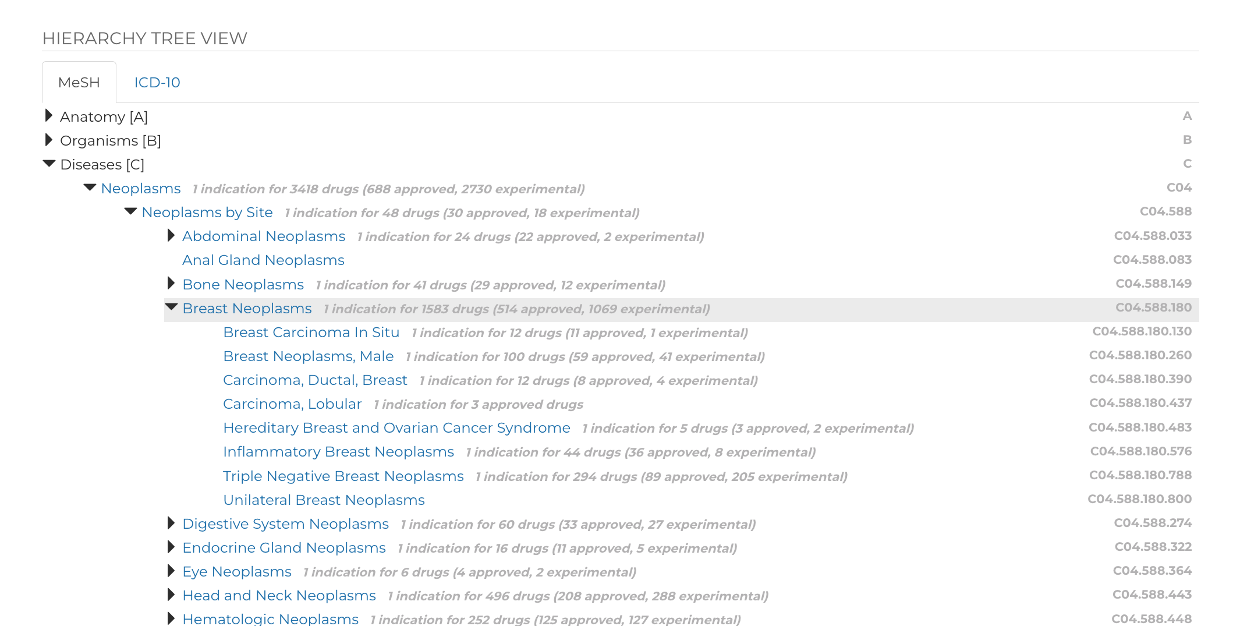
MeSH

Slide 9
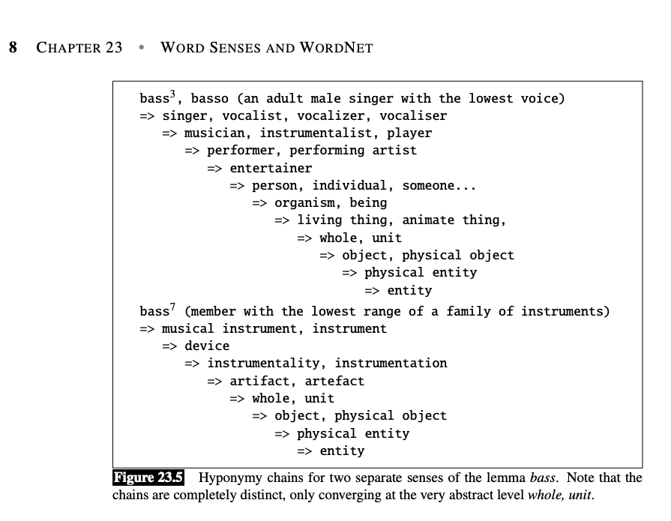
JM23

Slide 10
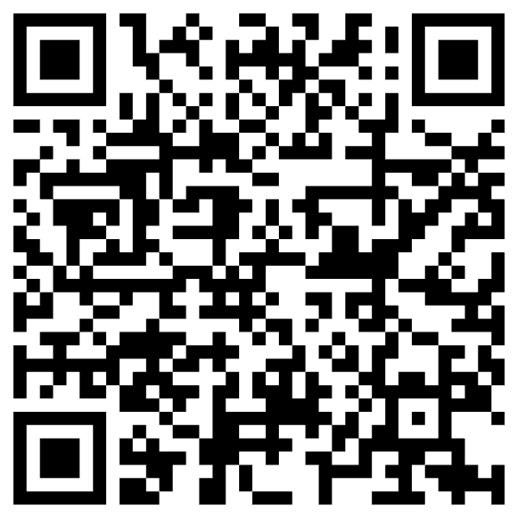
Tasks
Word Sense Disambiguation
bank → ``money’’ bank vs. ``river’’ bank
NER (Named Entity Recognition)
Find spans
Linking: Add hypertext links from texts to resources
Wikipedia
Pubtator
Co-reference
Which nouns refer to which nouns?
Pronoun resolution → Winograd Schema
Stance, Sentiment, Synonyms vs. Antonyms, Negation

Slide 11
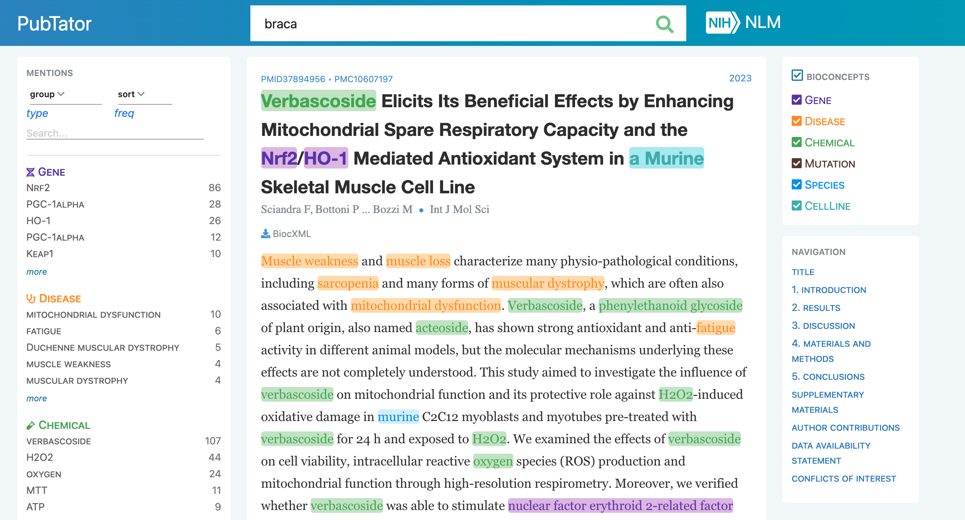
Pubtator

Slide 12
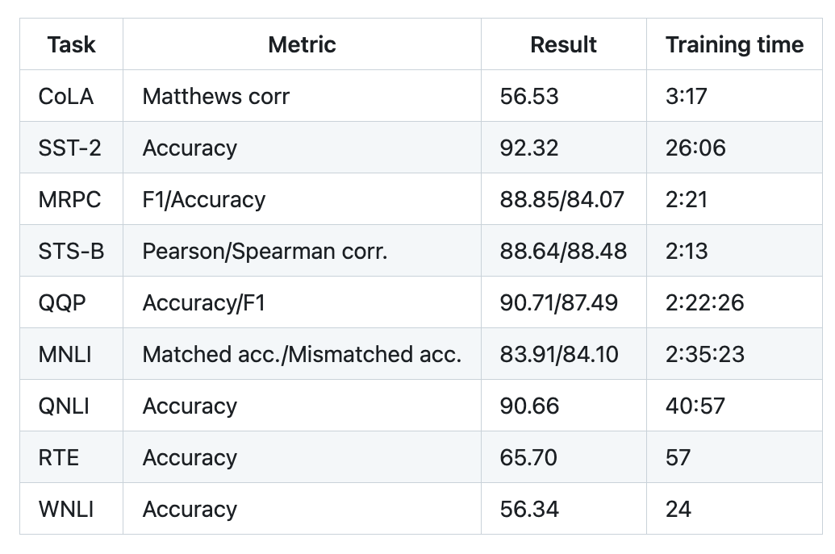
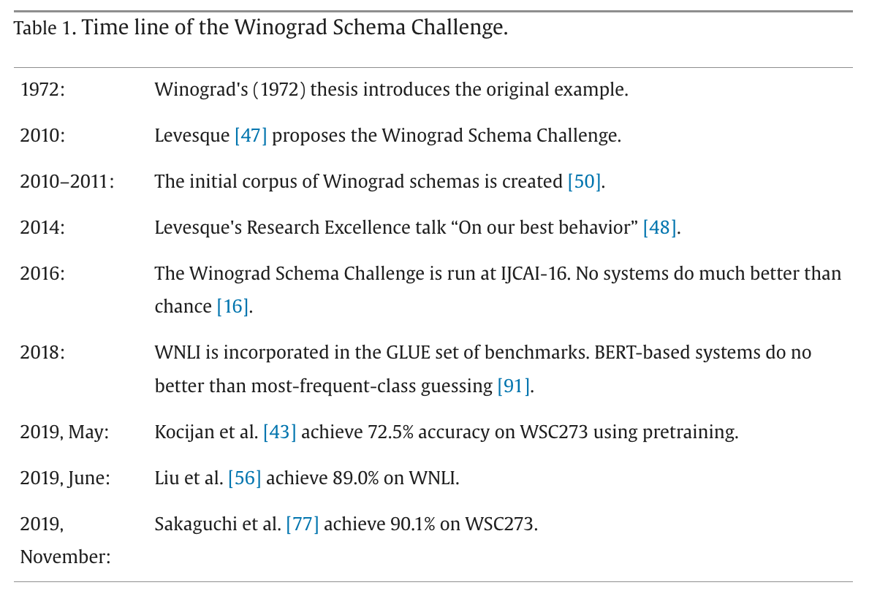
Winograd Schema (GLUE WNLI)
The trophy doesn't fit in the brown suitcase
because it is too large/small.
What is too large?
A. The trophy
B. The suitcase
Not much better than chance
from: https://doi.org/10.1016/j.artint.2023.103971

Slide 13
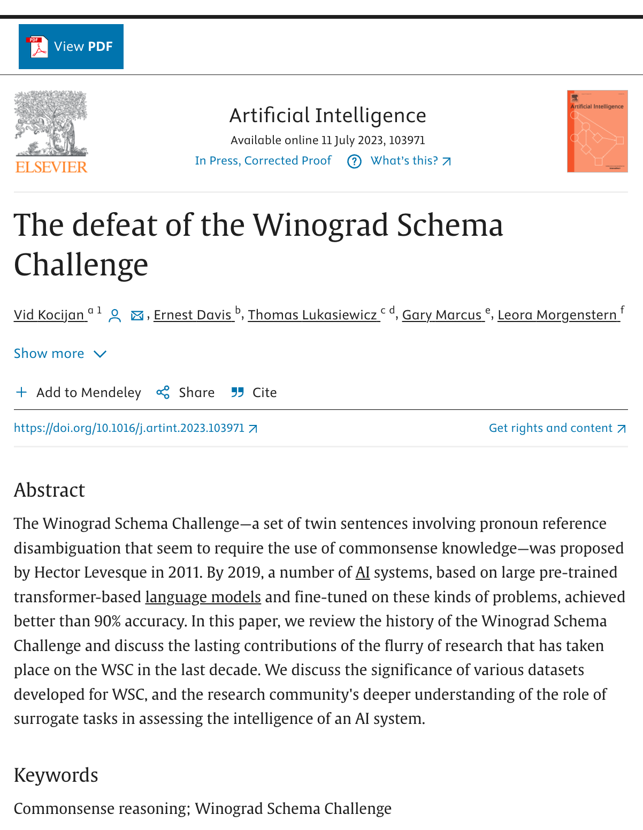
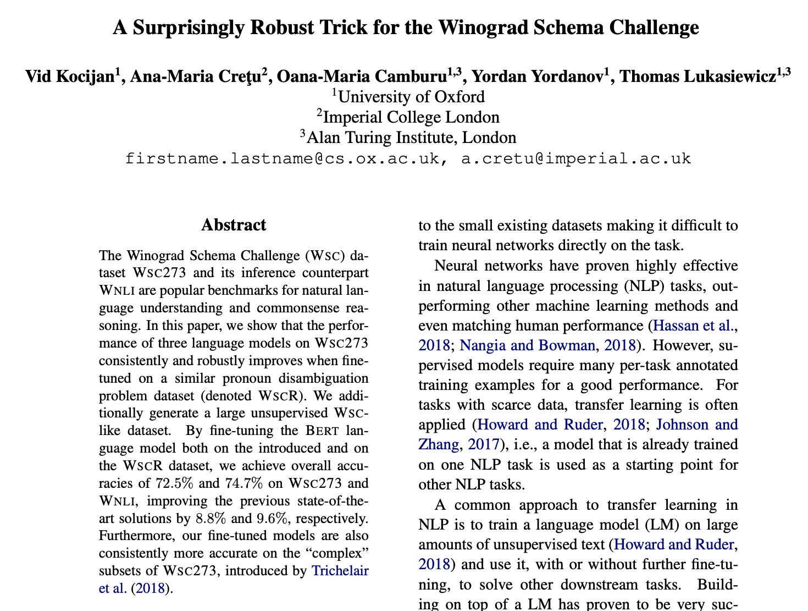
Winograd Schema (GLUE WNLI)

Slide 14
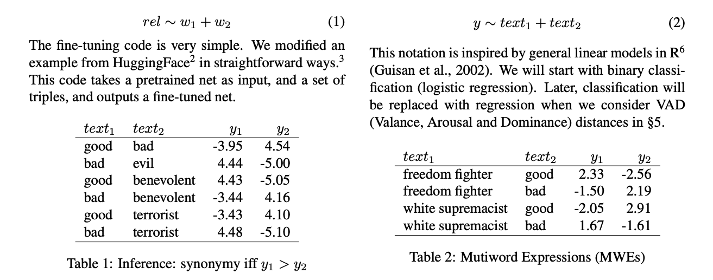
Training on Lexical Resources https://aclanthology.org/2022.lrec-1.676.pdf

Slide 15
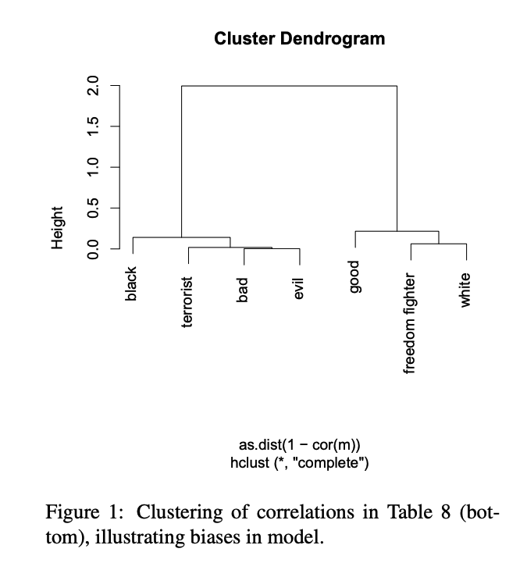
scipy dendrogram

Slide 16
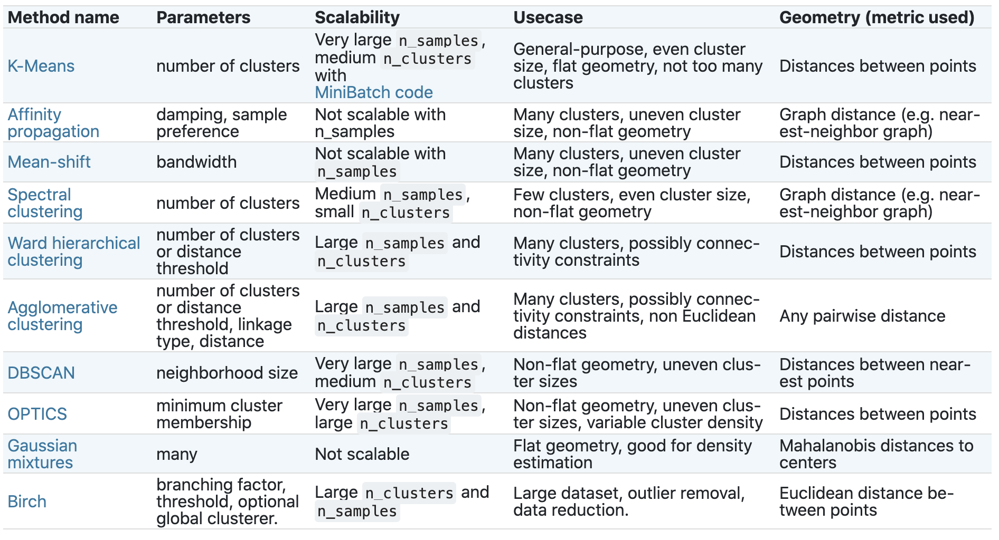
Clustering in Scikit-Learn
https://en.wikipedia.org/wiki/Hierarchical_clustering
https://en.wikipedia.org/wiki/K-means_clustering
https://scikit-learn.org/stable/modules/clustering.html

Slide 17
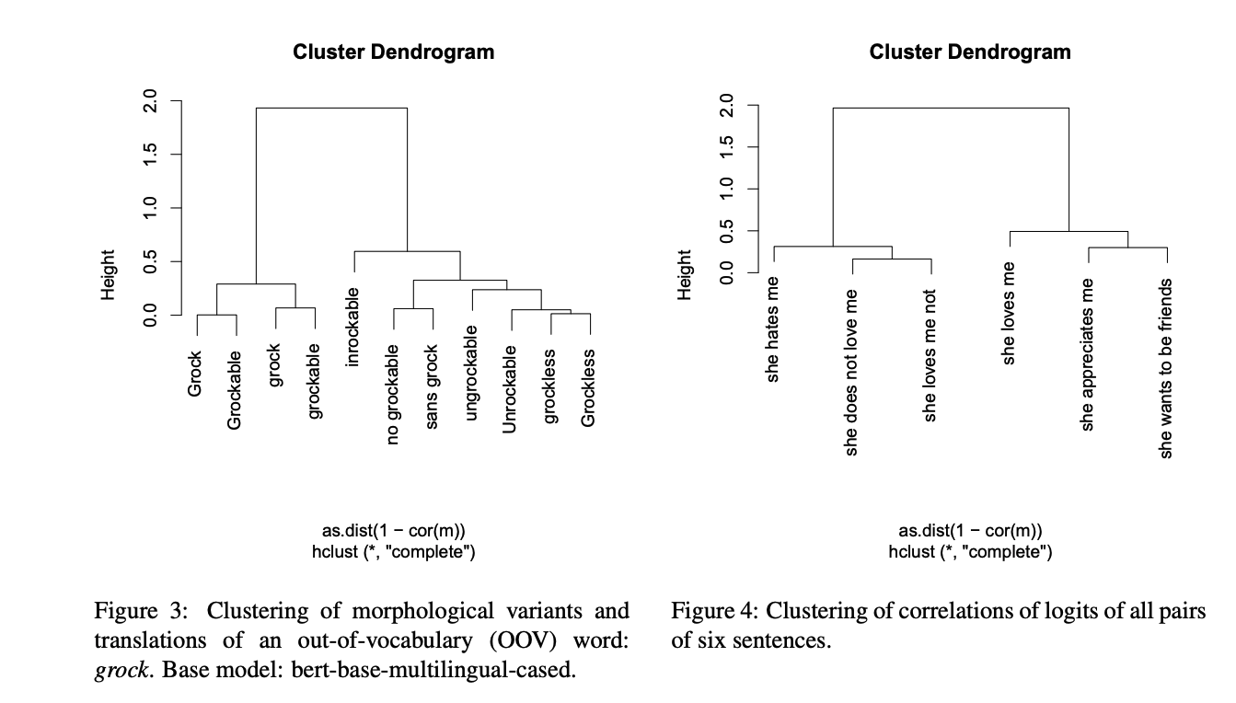

Slide 18
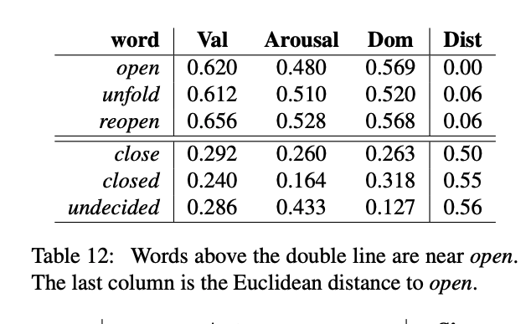

Slide 19
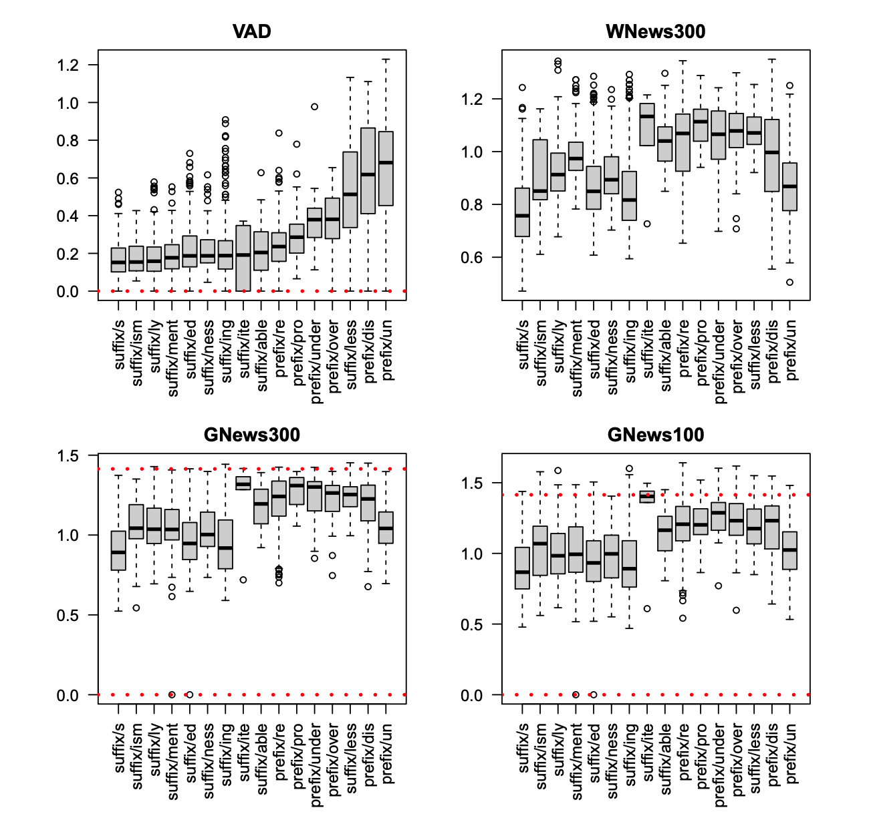

Slide 20

Lexical Resources International Conference on Language Resources and Evaluation (LREC)
Corpora
Non-parallel:
Brown, Penn Treebank, Wikitext
Parallel:
Hansards, Europarl
Ontologies
WordNet
MeSH (Medical Subject Headings)
Dictionaries
CMU Dict
Thesaurus
Roget’s
Synonyms and Antonyms
NRC-VAD
Knowledge Graphs
<head, relation, tail>
FreeBase (FB15k)
WordNet (WN18RR)

Slide 21
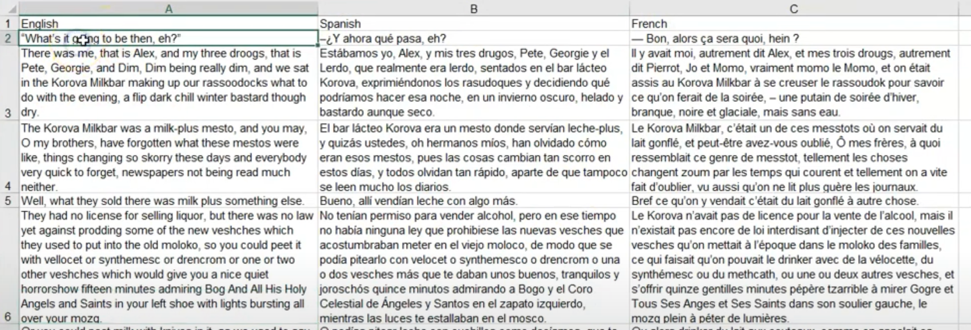
Example of Parallel Corpus https://youtu.be/1jeDPcWEYX0?t=80

Slide 22
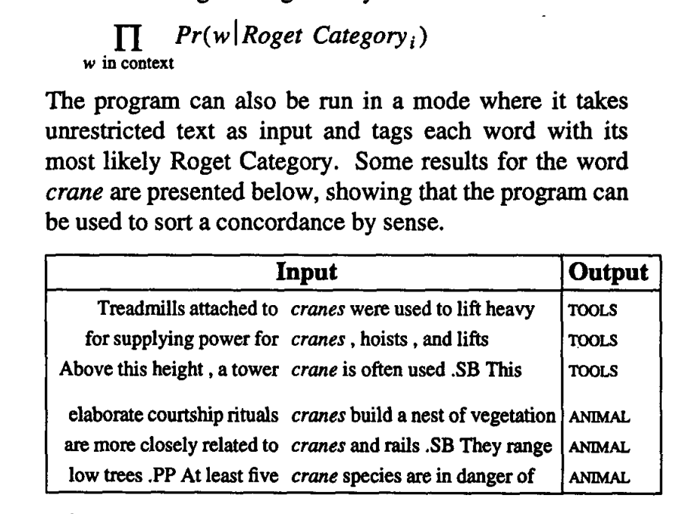
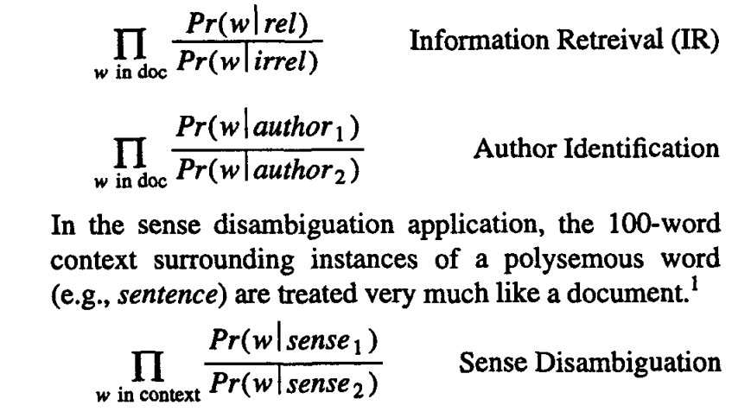
Applications for Parallel Corpora
Machine Translation
Word Sense Disambiguation
https://aclanthology.org/P92-1032.pdf

Slide 23
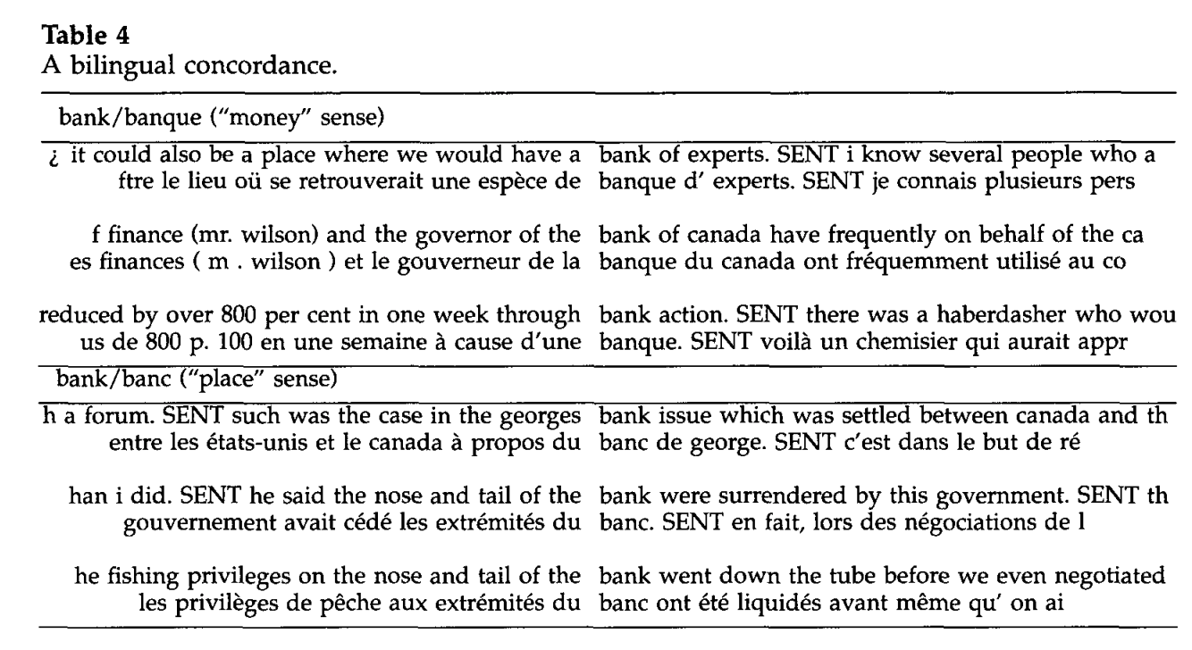
https://aclanthology.org/J93-1004.pdf

Slide 24
Co-Reference
Slides from last term
JM26
Two Noriegas

